Slide 1
6^{ο} Γυμνάσιο Μυτιλήνης
WELCOME TO OUR SCHOOL

Slide 2
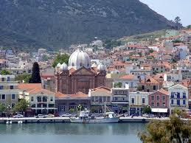
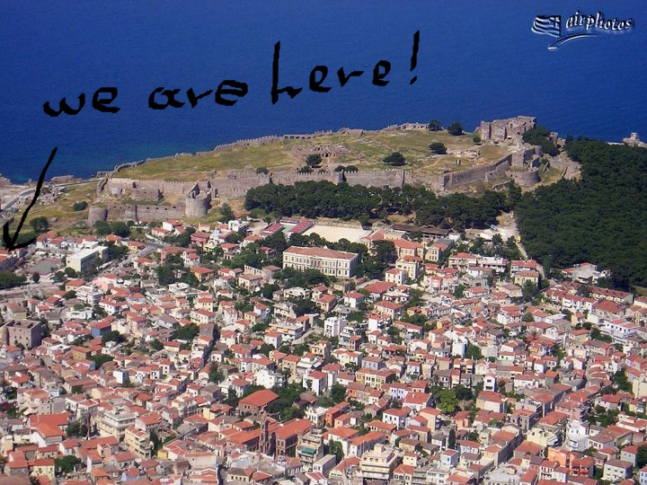

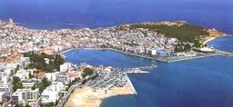
As we said, our school is in Mytilene…

Slide 3
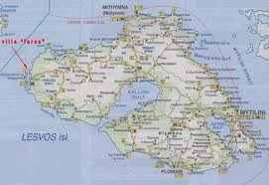
Mytilene is …..
Mytilene, the capital town of the island of Lesvos, has a population of 40.000. It is a beautiful city and is the island’s administrative and commercial centre.

Slide 4
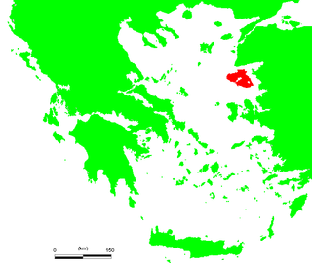
Lesvos is the third largest island in Greece…

Slide 5
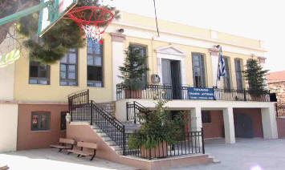
6^{ο} Γυμνάσιο Μυτιλήνης
«Γιάννης & Αριστείδης Δελής».
The Experimental Junior High School of Mytilene was founded in 1994 to cover the educational needs of the areas of Epano Skala and Synikismos in Mytilene.

Slide 6
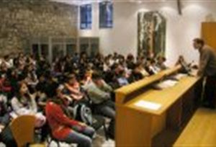
In the beginning…
The building was constructed in the last decades of the 19th century and, until the liberation of Lesbos, it housed a Turkish primary school and junior high school.

Slide 7
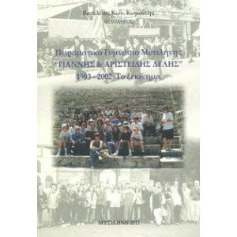
A little later…..
Later it was used as a sanitorium for patients with contagious diseases, then as a barracks and, in the 1950s, it housed the Health Services of Lesbos.

Slide 8
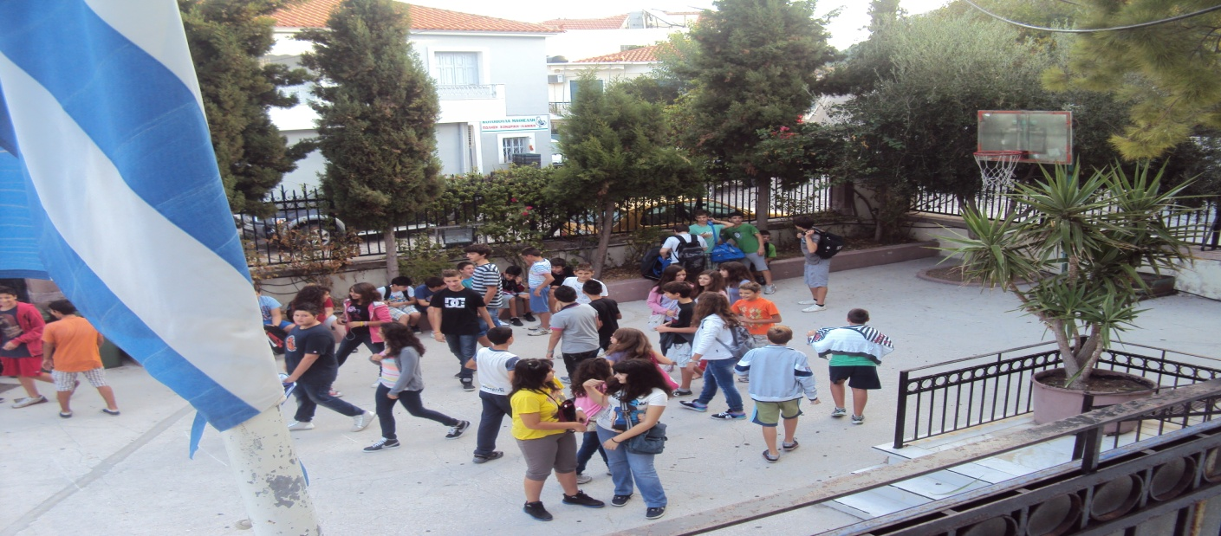
In 1994….
In 1994, the Experimental Junior High School was founded and had to specify its aims. The purpose of the Experimental School is the practical and pedagogical education of the pupils, together with the experimental application of programmes and teaching methods.

Slide 9
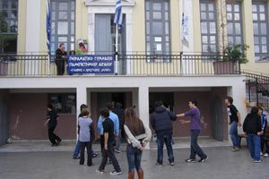
Τhe first conclusion….
The Experimental Junior High School overcame its organizational problems, acquired identity and was then opened officially with special events.

Slide 10
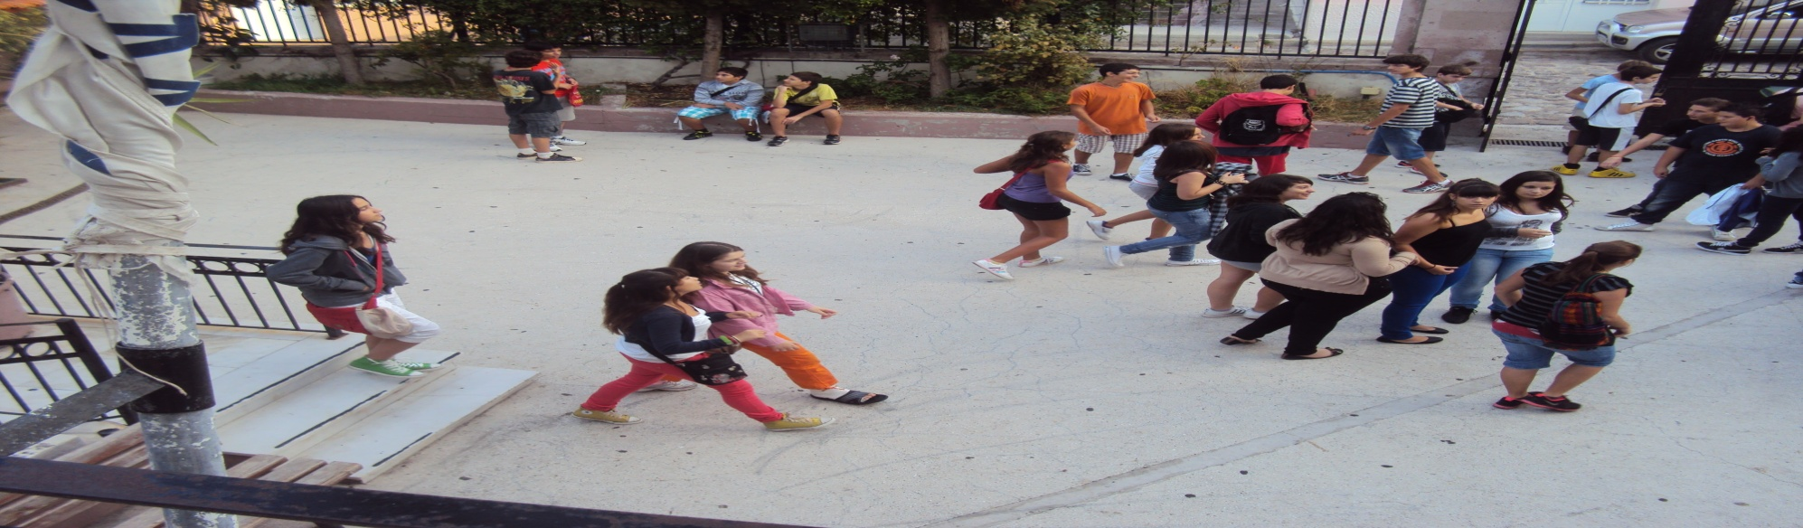
Another conclusion….
Our school is also very active. It has taken part in many activities such as theatre & publication of a school newspaper & has participated in school programmes.

Slide 11
So we have to say….
These pupils participated in the programme of twinning between our school and the Makedonitissa School in Cyprus(2004).
Αντωνάκης Ανέστης Γ₁
Αντωνίου Αλέξανδρος Γ₁
Κουγκούλιος Δημήτριος Γ₁
Παυλής Γιάννης Γ₂
Ταξείδης Γιώργος Β₂
Πρασσάς Αντώνης Α₂
Καραγιάννη Παναγιώτα Γ₁
Λάσκαρη Ιωάννα Γ₁
Στεργίου Σταματίτσα Γ₂
Τσιτμιδέλλη Ασημένια Γ₂
Χατζηκομνηνού Ειρήνη Α₂
Βέτσικα Βασιλική

Slide 12
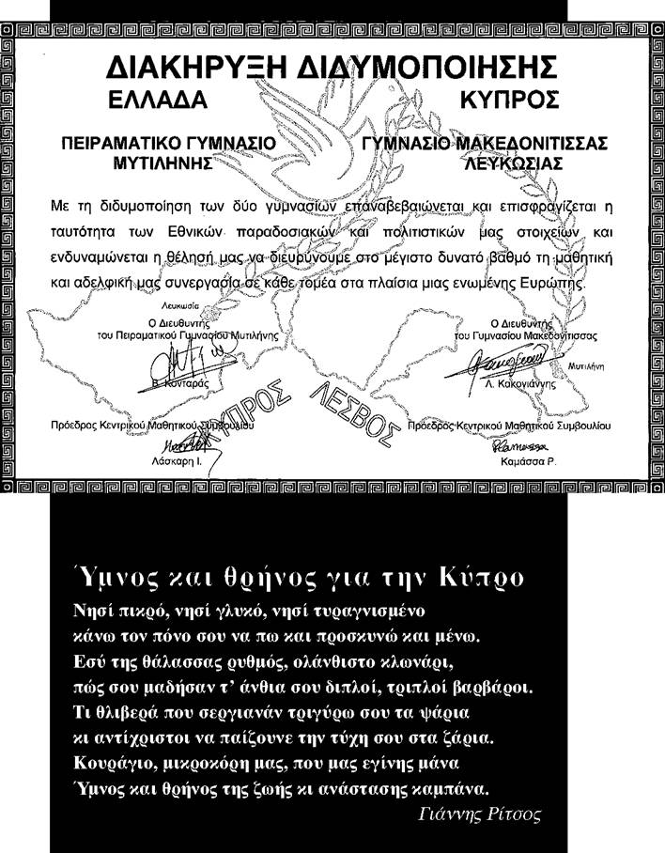
Here is the declaration of the twinning…

Slide 13
Something else. An environmental programme in which we participated..

Slide 14
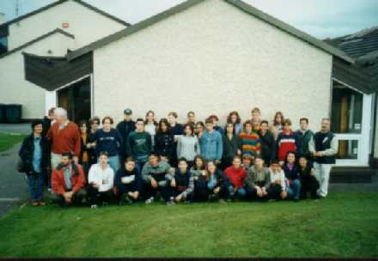
During the programme “Energy Education in Schools” we visited the Irish (2001).

Slide 15
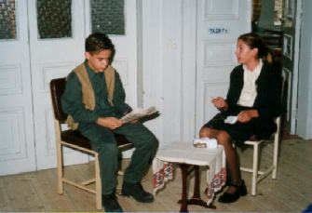
This is a scene from a theatrical production in our school….

Slide 16
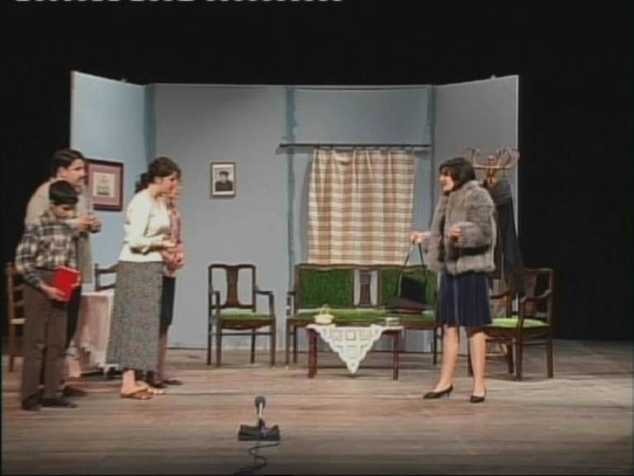
From the play “The Monster of the Bull”,
Mytilene Municipal Theatre, April 2006.

Slide 17
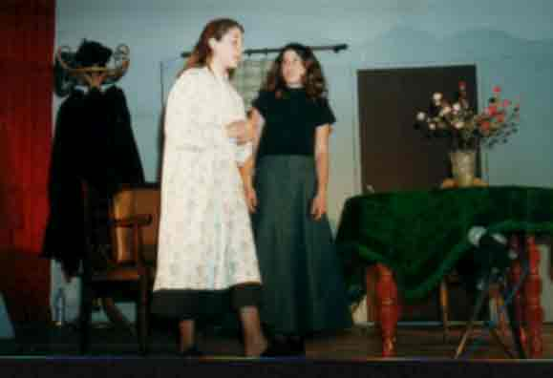
Another play we put on in Mytilene Municipal Theatre, “Goodnight Margarita”.

Slide 18
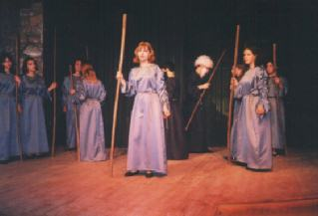
Greek tragedy in our school:
Sophocle’s “Antigone”…

Slide 19
These are the awards given to us for school activities involving both teachers and pupils.
Θεατρική Παράσταση "Ιφιγένεια εν Ταύροις". Ειδική διάκριση ερμηνείας, στους Πανελλήνιους μαθητικούς αγώνες Αρχαίου Δράματος.
Θεατρική παράσταση "Υπηρέτης δύο αφεντάδων". Ειδική διάκριση στους Περιφερειακούς μαθητικούς αγώνες θεάτρου Αιγαίου.
Θεατρική παράσταση "Καληνύχτα Μαργαρίτα". Α! βραβείο στους Περιφερειακούς μαθητικούς αγώνες θεάτρου Αιγαίου.
Έπαινος από την Ελληνική Εταιρία Προστασίας της Φύσης, για τη συμμετοχή του στο Ευρωπαϊκό Πρόγραμμα Περιβαλλοντικής Εκπ/σης.
Βραβείο ΚΑΠΕ (Κέντρο Ανανεώσιμων Πηγών Ενέργειας) 2000, για την εργασία των μαθητών της Περιβαλλοντικής ομάδας του σχολείου με θέμα "Ενέργεια και Αειφορία".
Βραβείο Πανελλήνιου Πνευματικού Κέντρου "Ο ΦΙΛΩΝ", για την έντονη πολιτιστική δραστηριότητα του σχολείου.

Slide 20
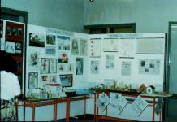
This is our corner in an exhibition of school educational programmes.

Slide 21
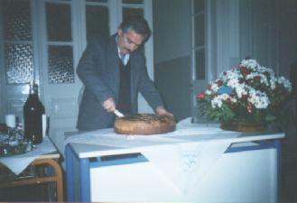
Some moments we always remember… cutting the traditional cake on the first day of the year.

Slide 22
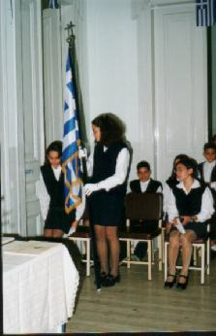
Flag Day….

Slide 23
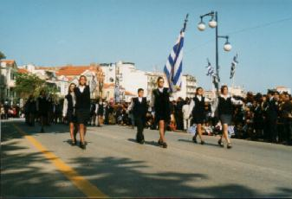
Pupils of the Experimental Junior High School of Mytilene taking part in the parade (28th October)….

Slide 24
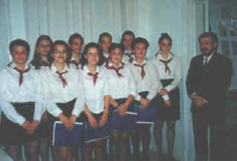
The Experimental Junior High School of Mytilene has a great choral tradition as well…

Slide 25
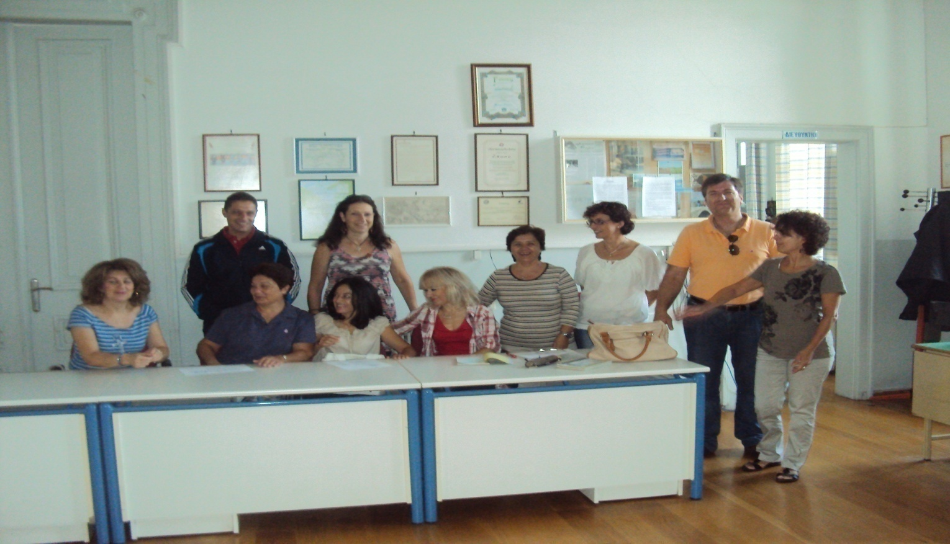
Our school today.
Some of our 19 teachers….

Slide 26
Our teachers….
5 Greek Philology teachers
2 Mathematics teachers
3 Physics teachers
1 German teacher
1 French teacher
1 English teacher
1 Music teacher
1 Art teacher
1 Theology teacher
1 Computer teacher
1 Gym teacher
1 Technology teacher

Slide 27
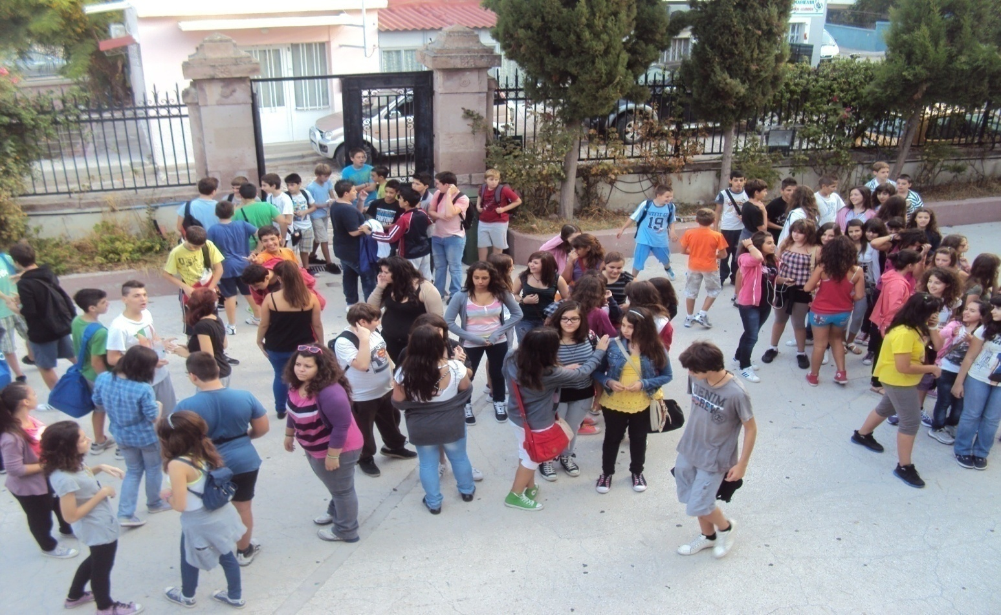
And….
117 pupils…..

Slide 28

There are three years with two classes in each year: A1, A2, B1, B2, C1, C2.

Slide 29
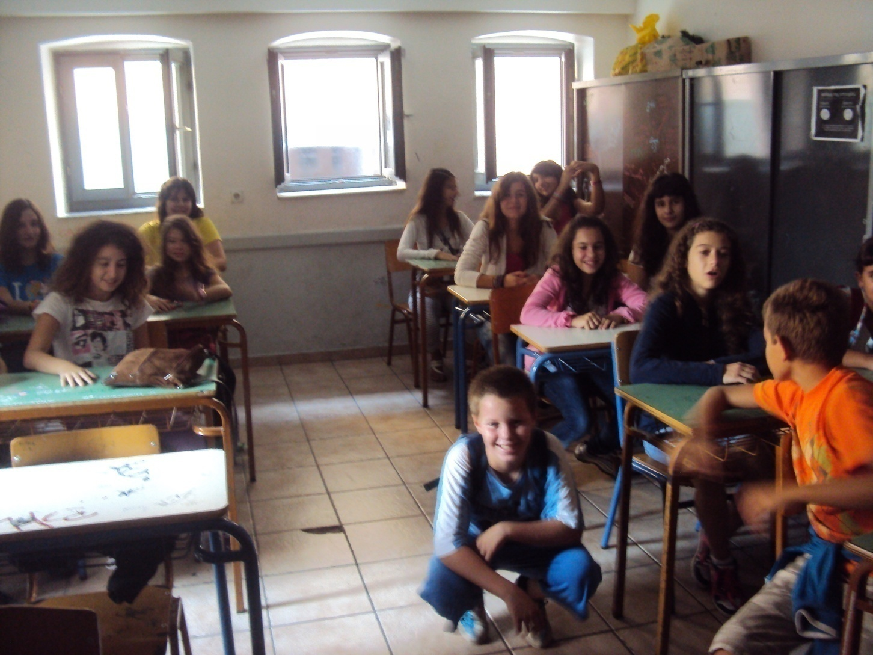
A1=19 pupils, 6 boys and 13 girls.

Slide 30
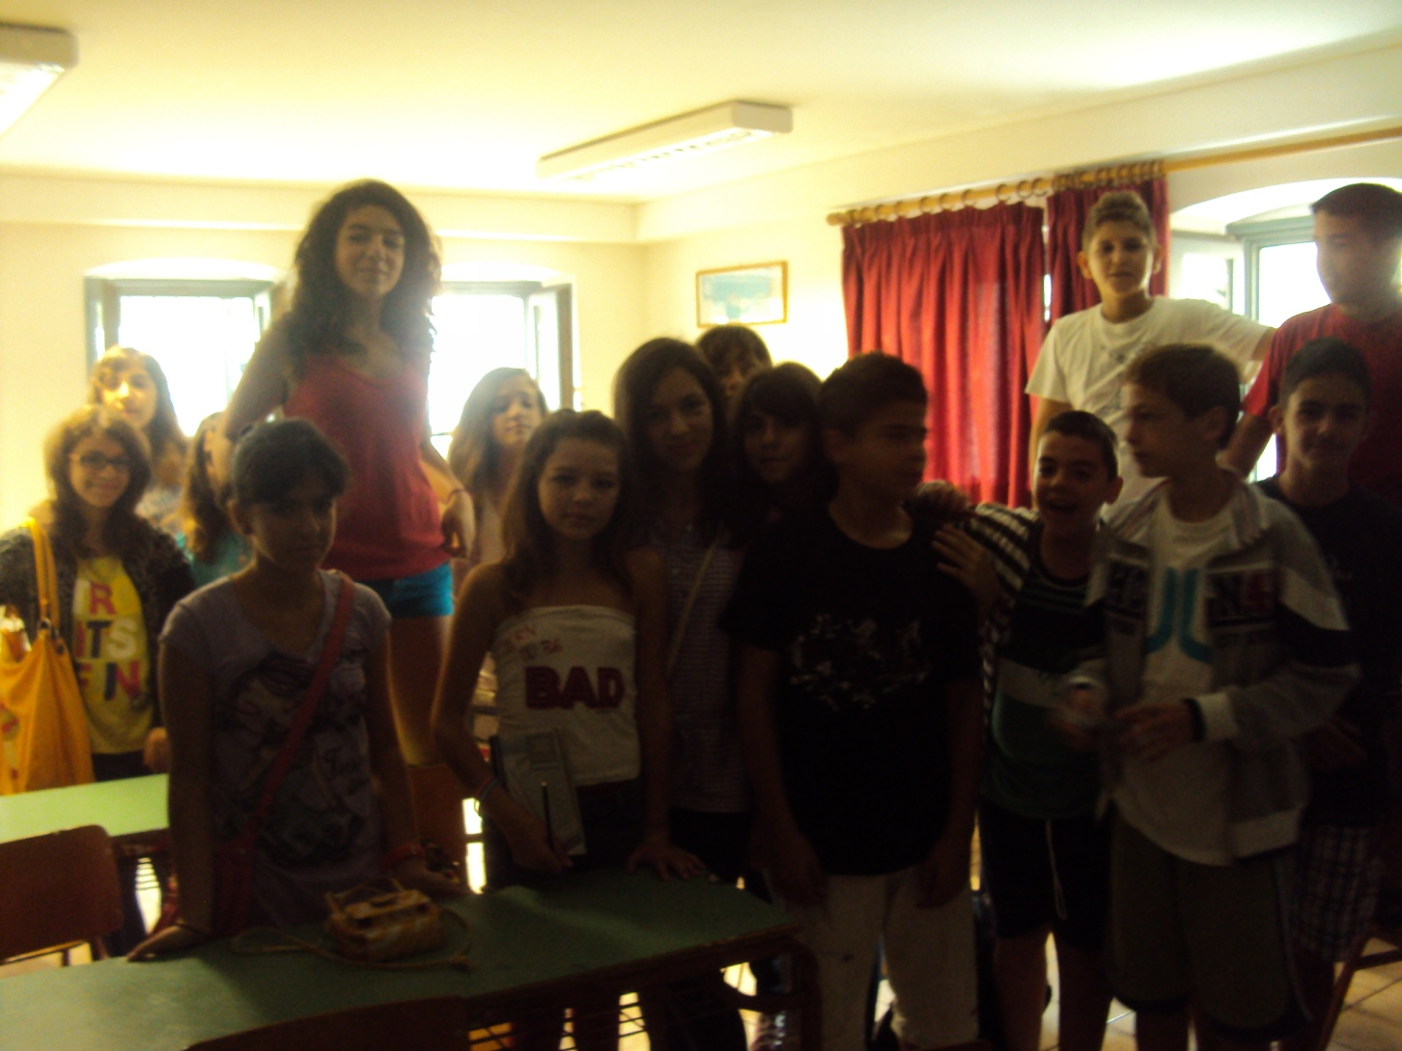
A2=18 pupils, 6 boys and 12 girls.

Slide 31
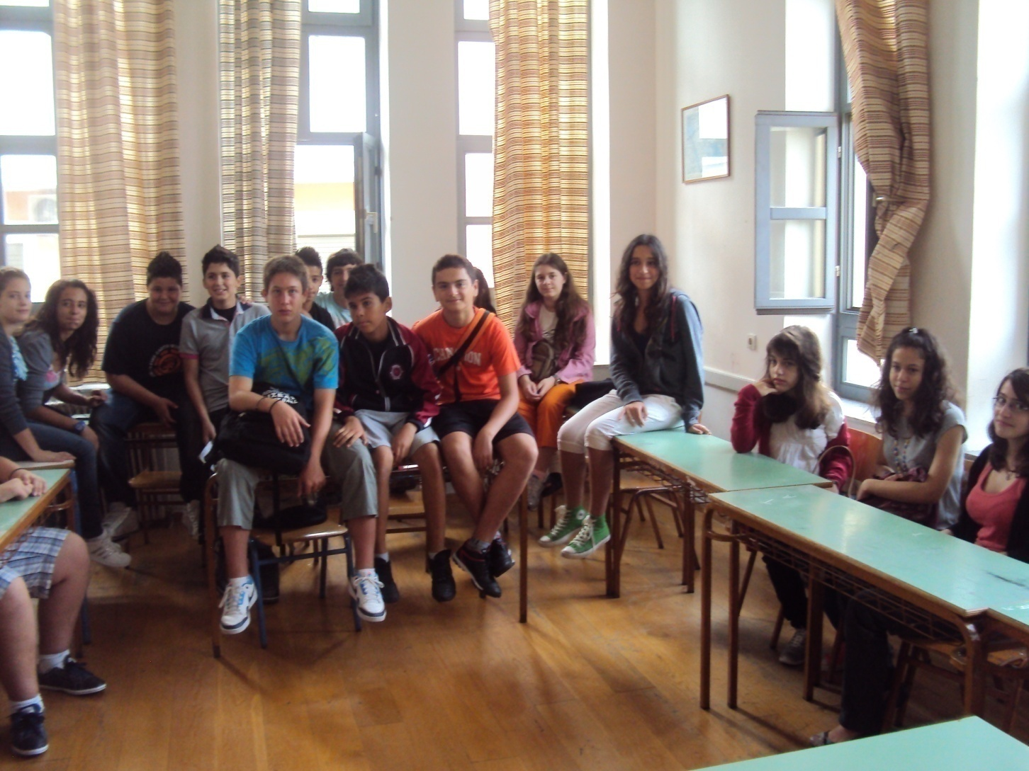
B1=21 pupils, 10 boys and 11 girls.

Slide 32
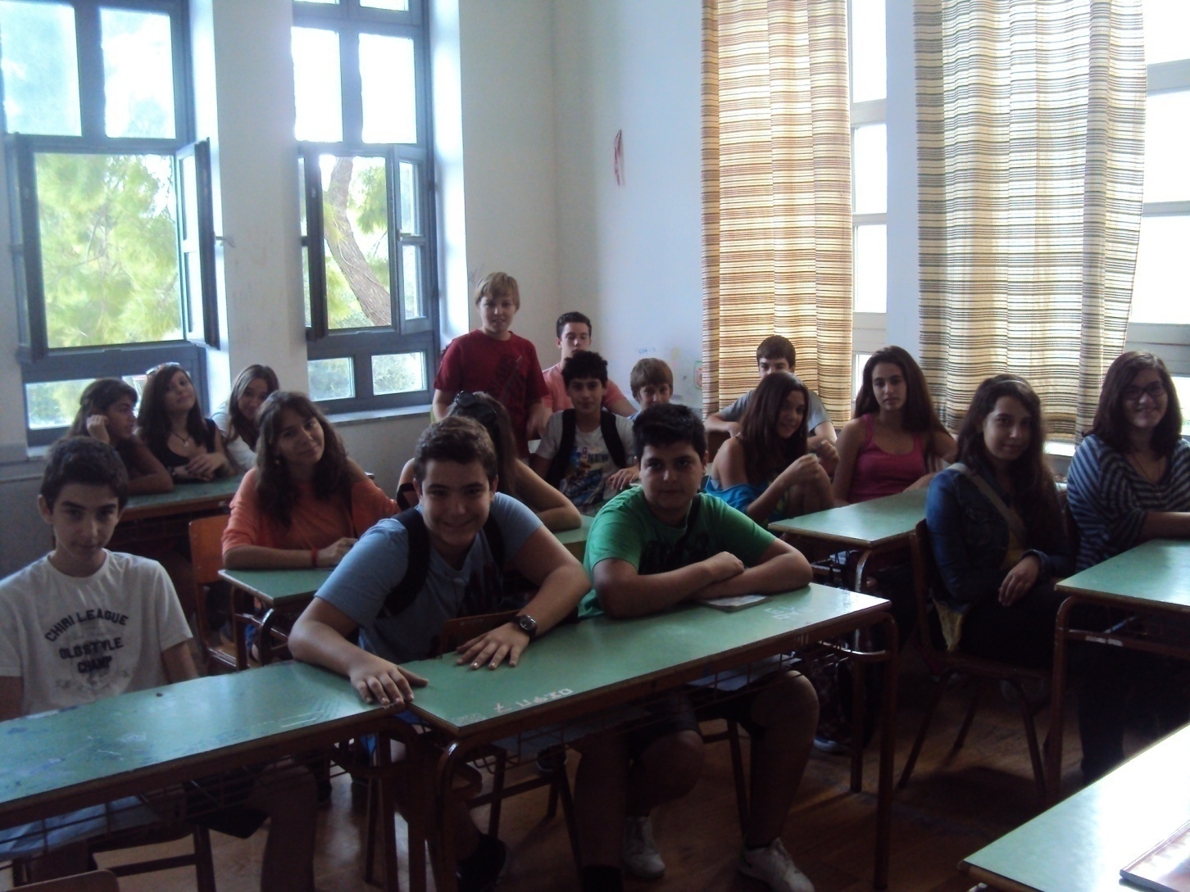
B2=19 pupils, 9 boys and 10 girls.

Slide 33
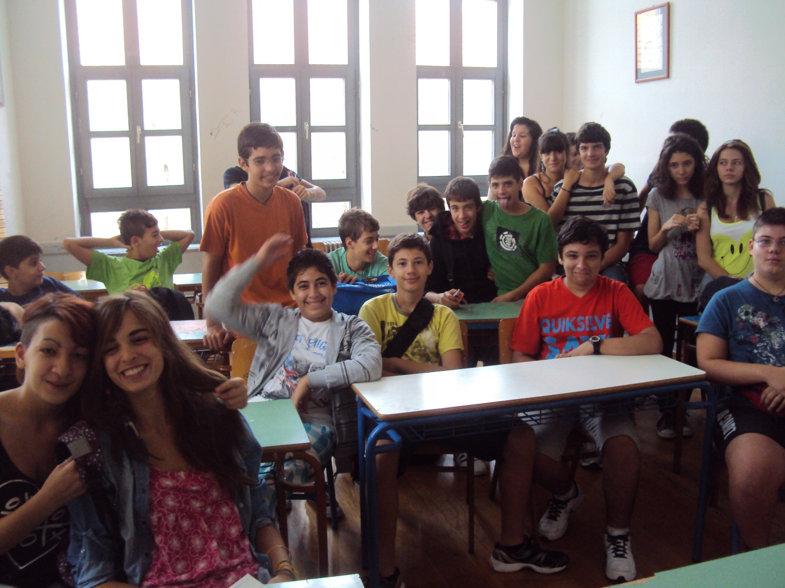
Γ1=19 pupils, 10 boys and 9 girls.

Slide 34
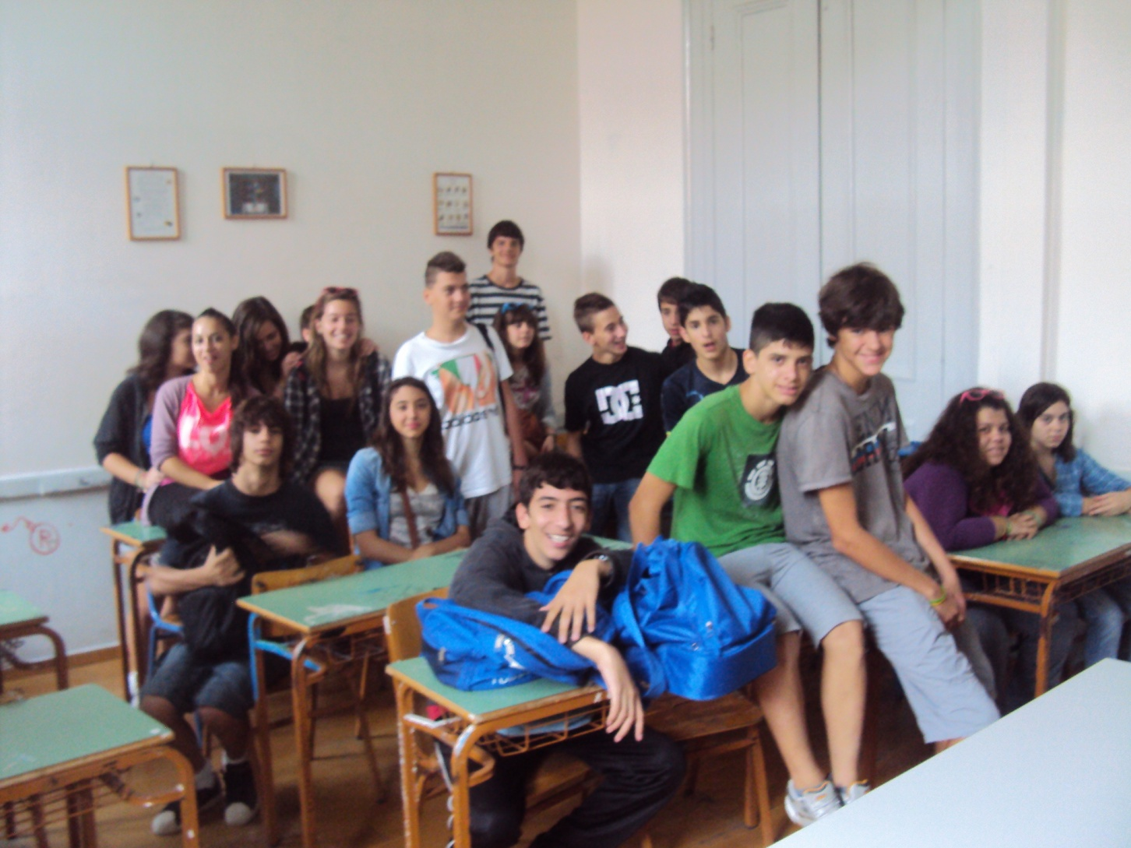
Γ2=21 pupils, 11 boys and 10 girls.

Slide 35
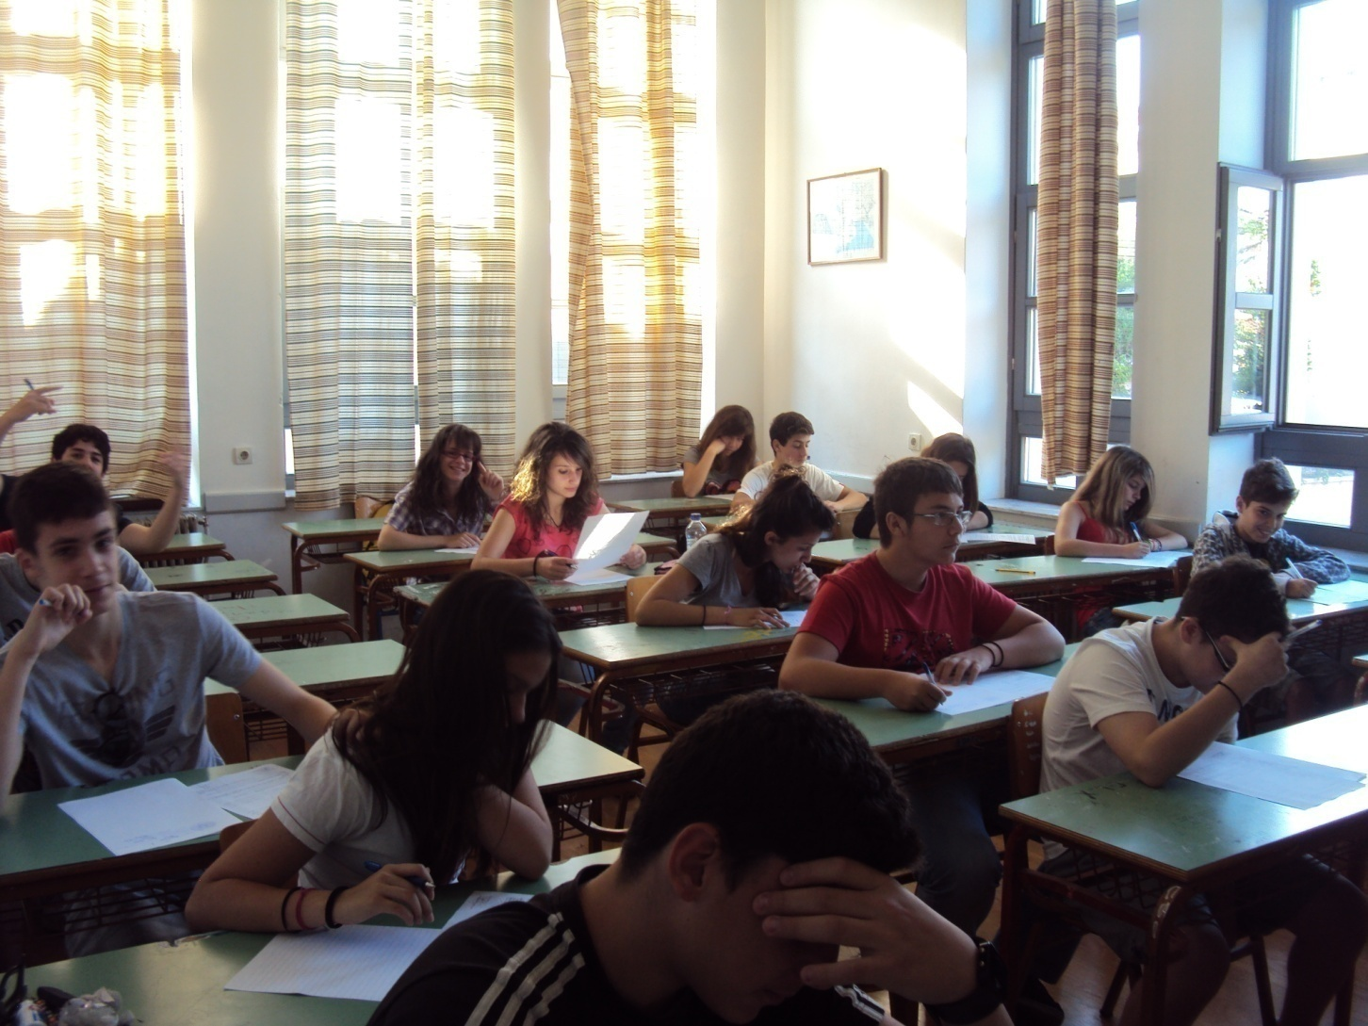
We have six classrooms…

Slide 36
which are very beautiful!

Slide 37
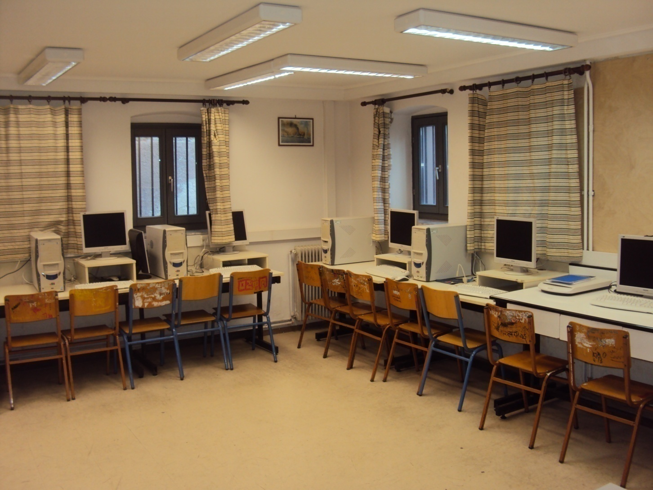
We have a computer lab.

Slide 38
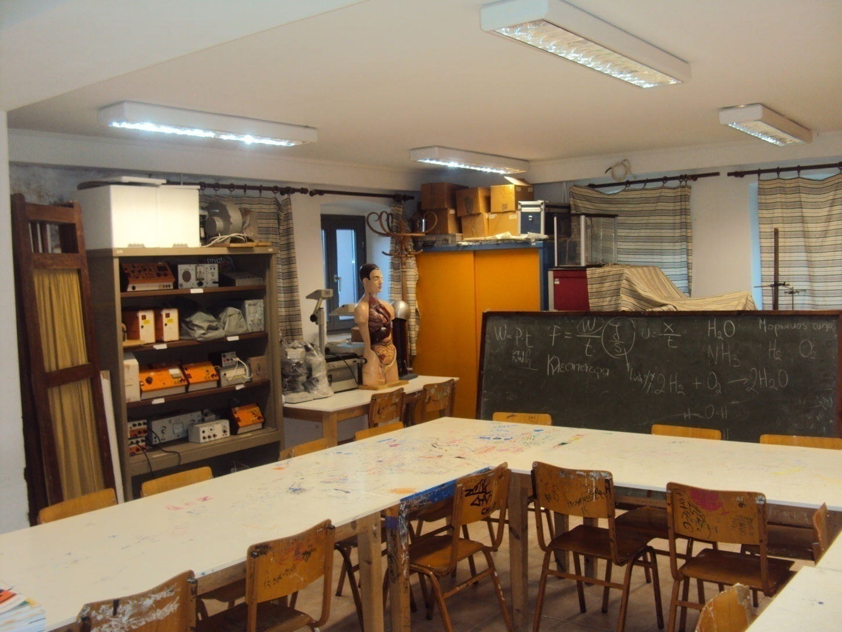
We also have a science lab.

Slide 39
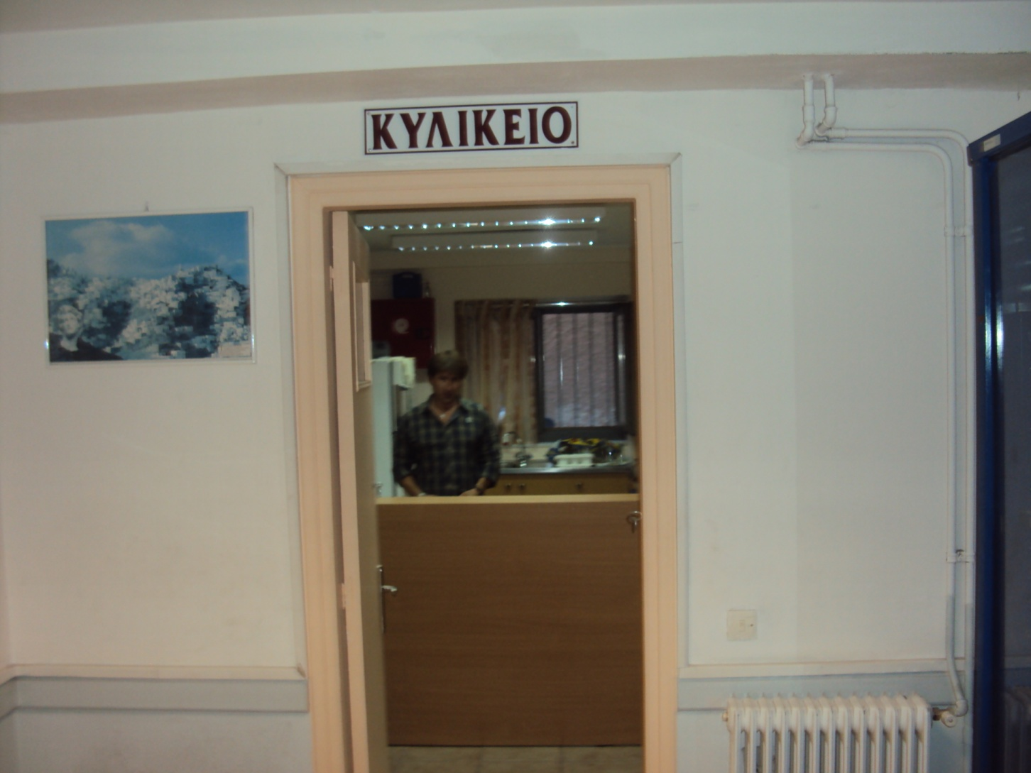
There is a beautiful tuck shop in case we get hungry…

Slide 40
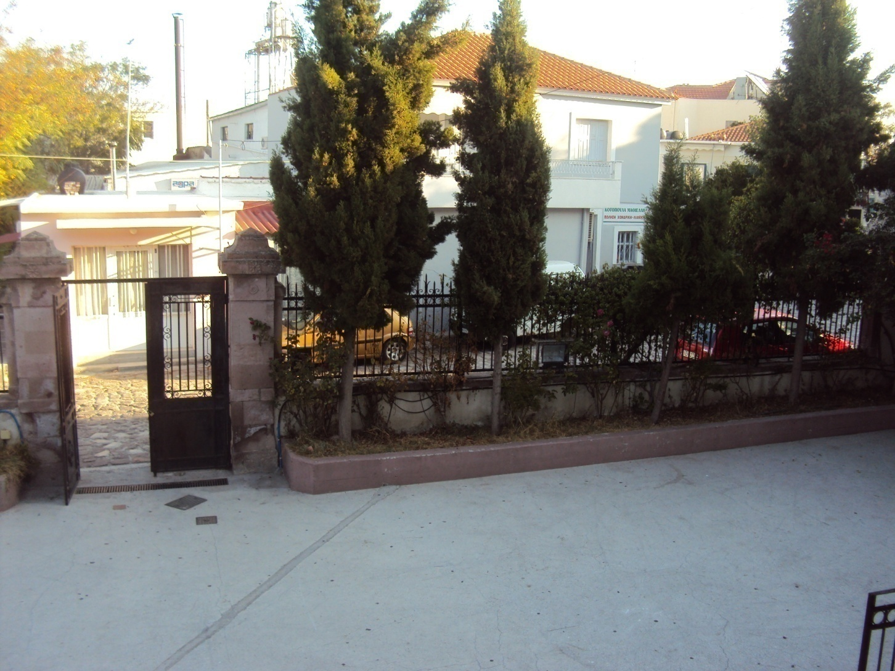
Here is our school yard.

Slide 41
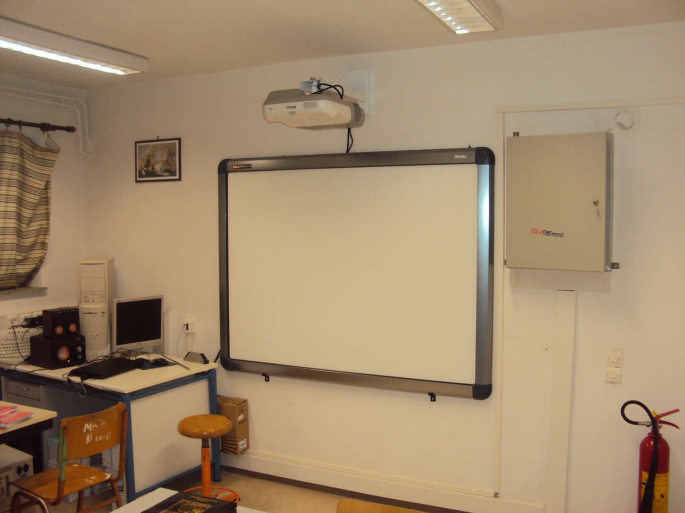
There are two interactive whiteboards…

Slide 42
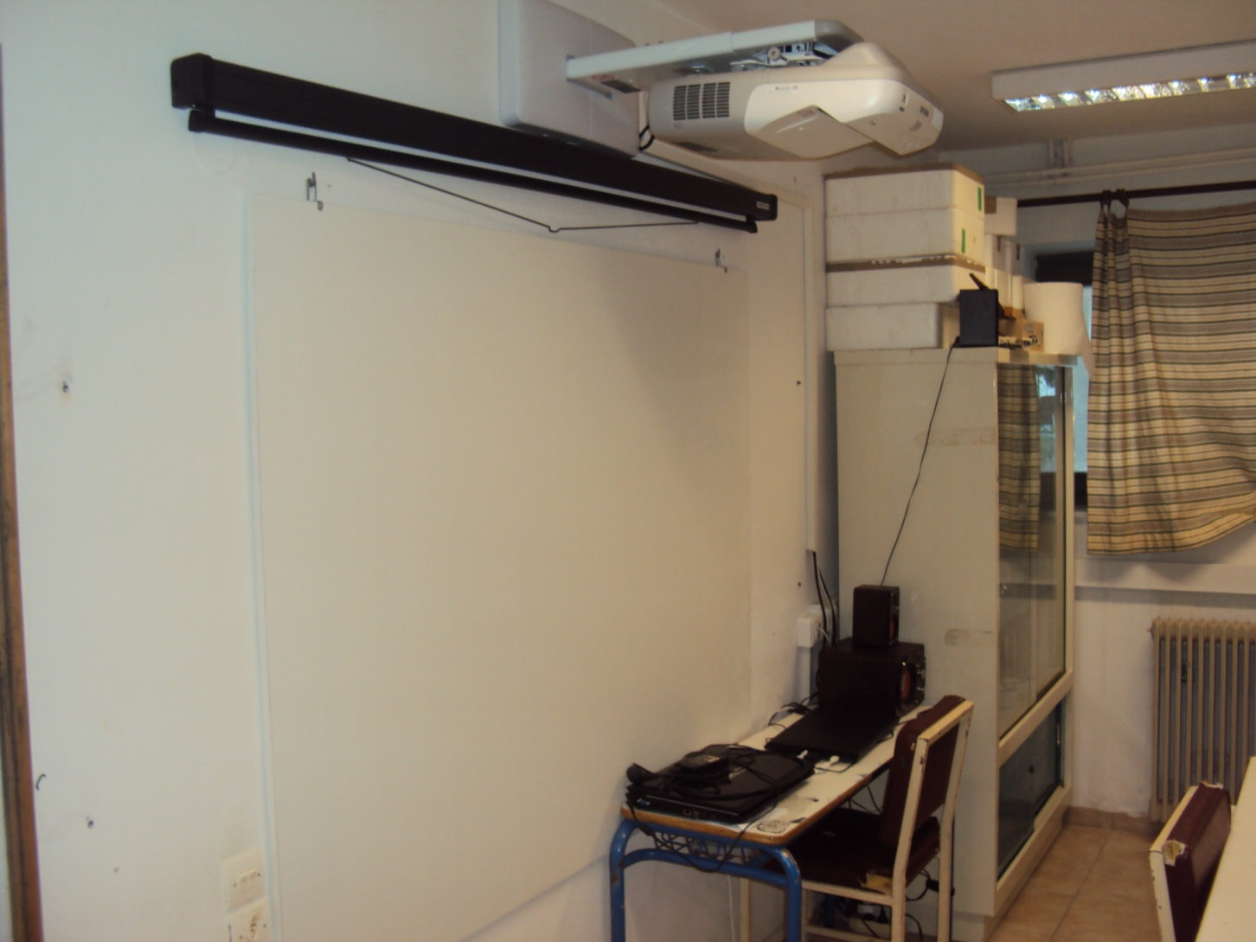
and a white screen for projection.

Slide 43
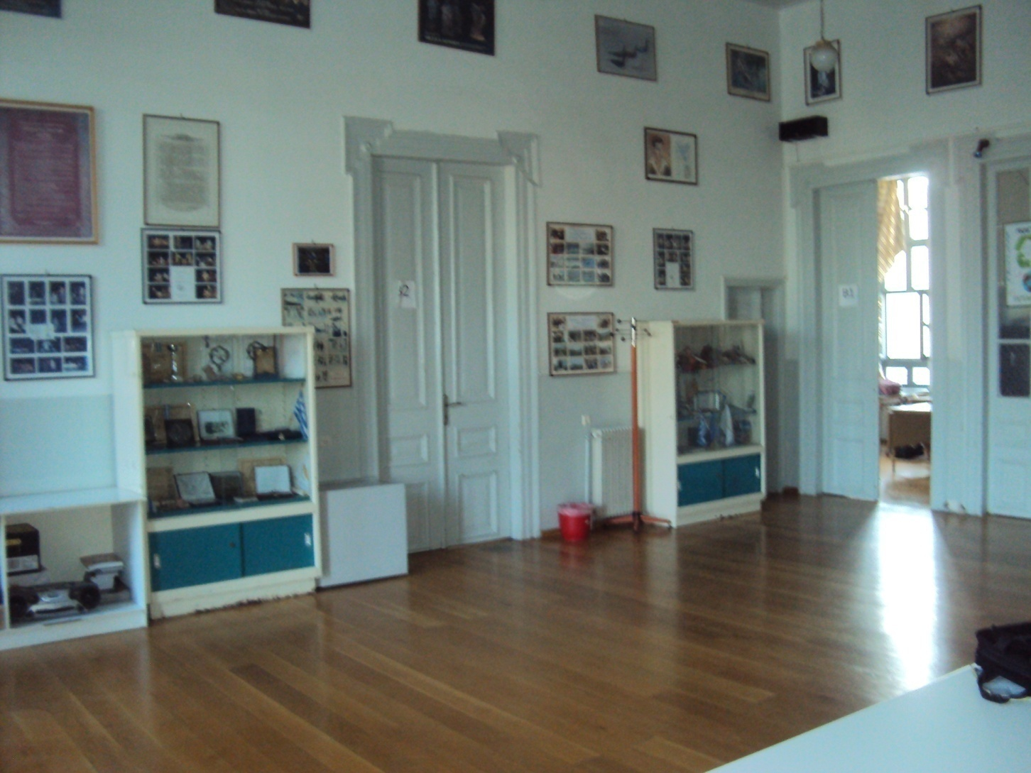
We have a central hall which is used for events.

Slide 44
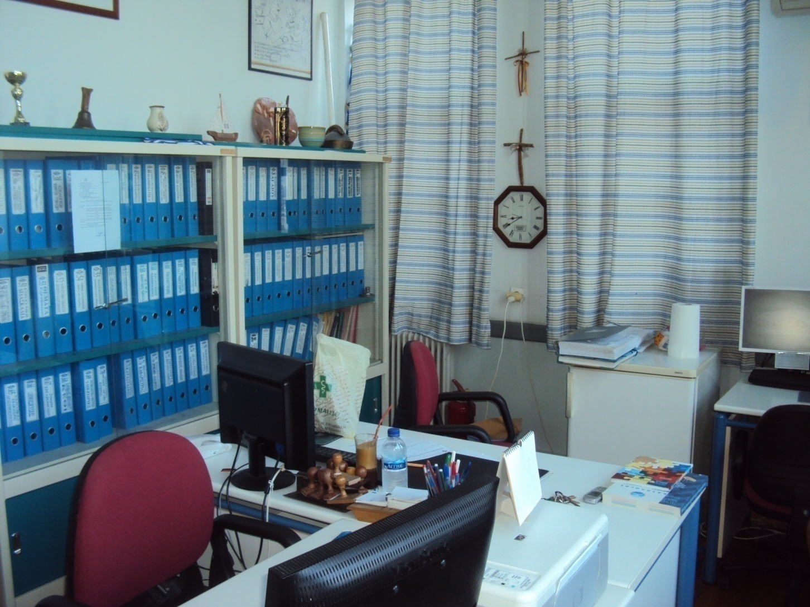
And finally, this is the small office of the headmaster and teachers.

Slide 45
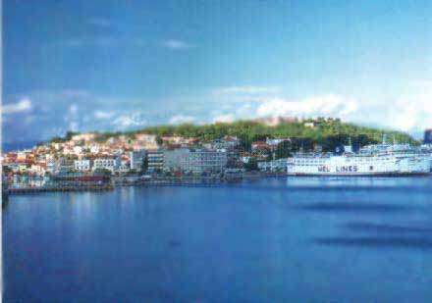
Thank you very much for your attention.

